Slide 1

Twitter Sentiment Analysis
Sharrae Allen
Ironhack DAPT Final Project

Slide 2
Goals
Use natural language processing techniques to analyze the sentiment of the two United States official political parties’ Twitter accounts.
01
Determine which party tweets more negatively.
02
Predict the sentiment of future tweets.
03

Slide 3
What is Natural Language Processing?
Natural language processing (NLP) is the automatic manipulation of everyday communication in human languages so computers so process and understand them.
Sentiment analysis uses statistics, NLP, and machine learning to “determine the emotional meaning of communications.” (Korolov)
Sentiment Labels
Positive
Negative
Neutral

Slide 4


Dataset: The Republicans
The Republican National Committee
Political Right
Username: @GOP
Latest 3,188 Tweets

Slide 5
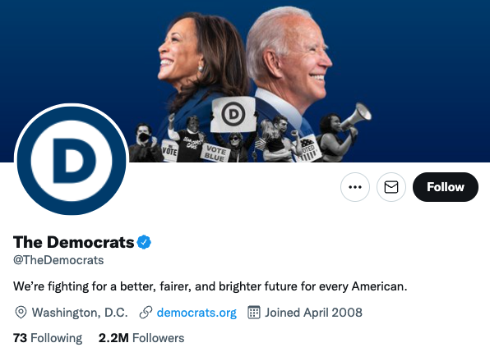
Dataset: The Democrats
The Democratic National Committee
Username: @TheDemocrats
Latest 3,233 Tweets
Political Left

Slide 6
Techniques
Twitter API user-timeline
Natural Language Toolkit
TextBlob Library
Logistic Regression Model
roBERTa Twitter SA Model

Slide 7
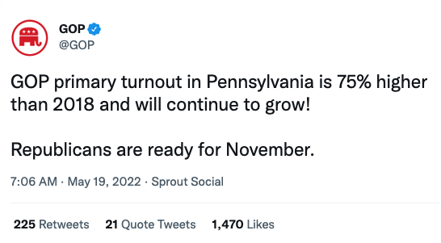
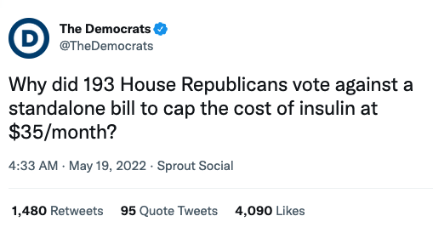
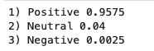
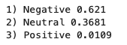
roBERTa Twitter Sentiment Analysis Model
Sentiment Scores

Slide 8
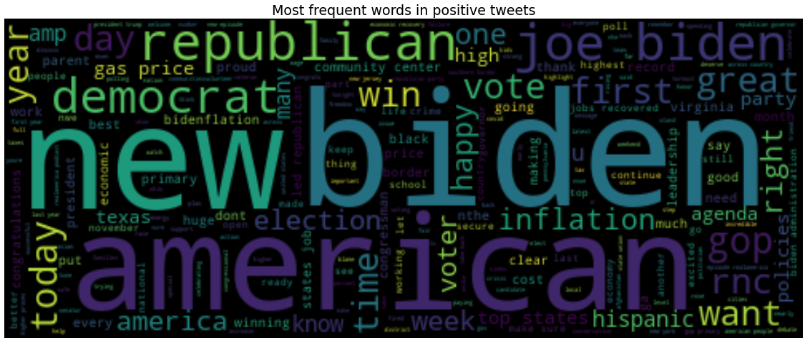
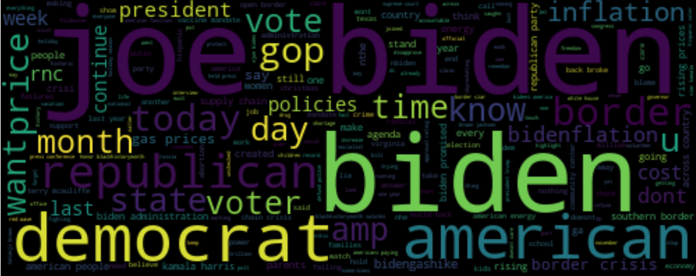
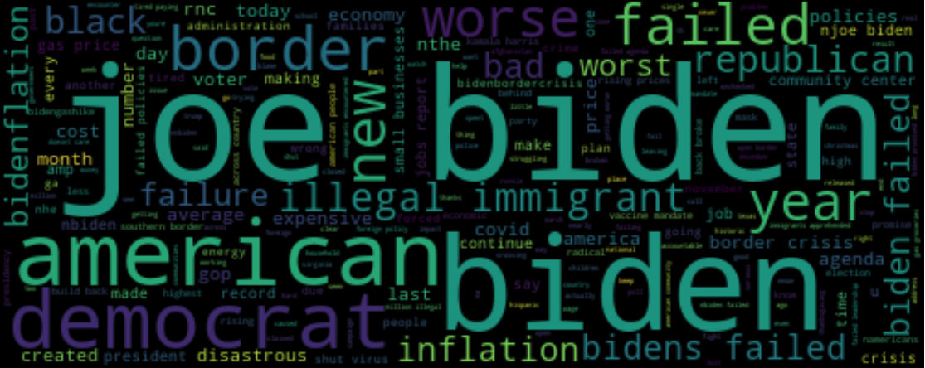
NLTK Findings: GOP
Positive
Neutral
Negative

Slide 9

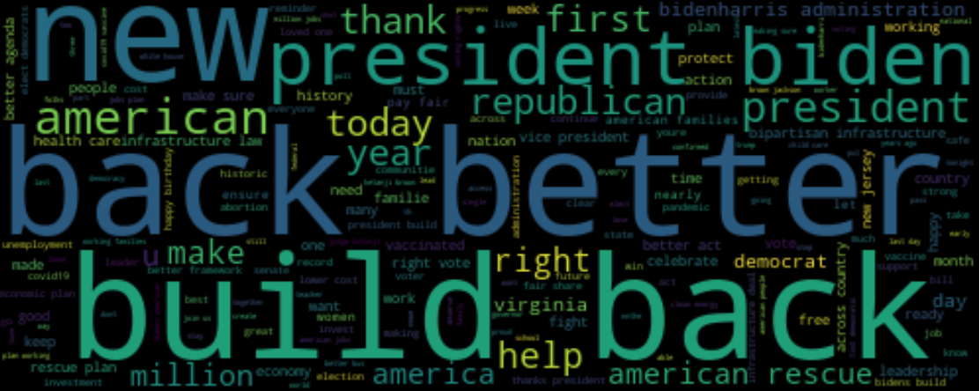
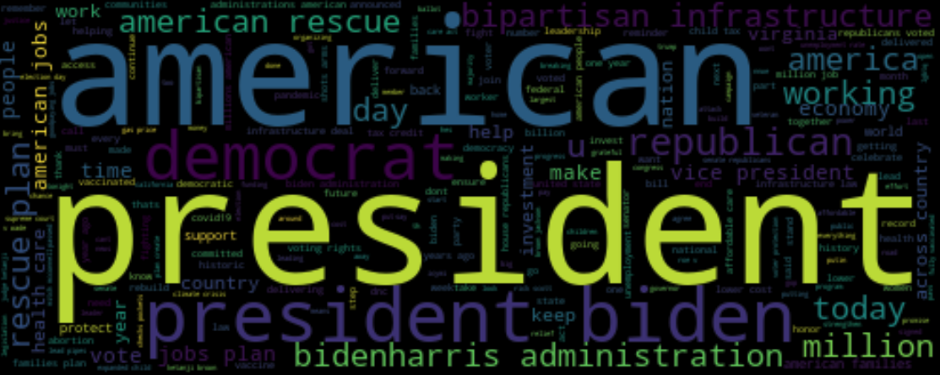
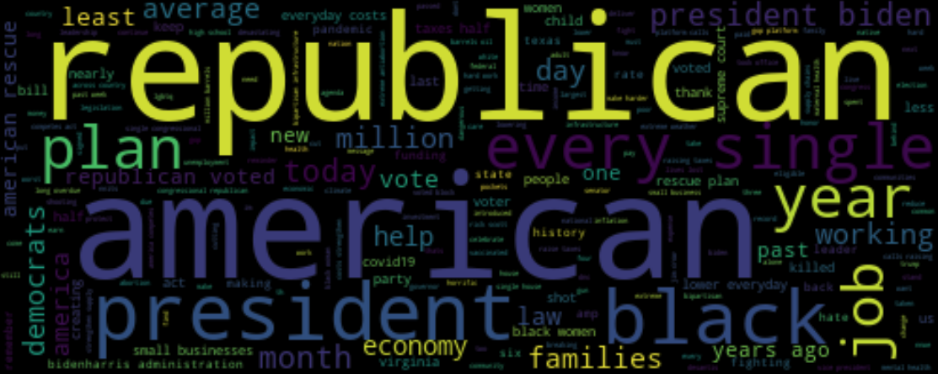
NLTK Findings: DNC
Positive
Neutral
Negative

Slide 10
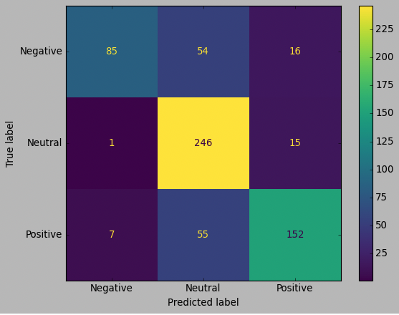
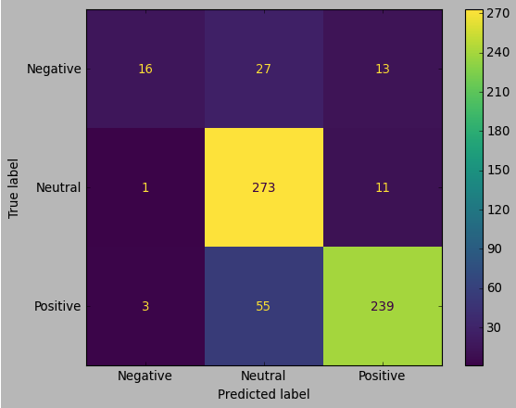


Logistic Regression Results

Slide 11
Conclusions
NLP sentiment analysis was successful but needs more models added to analysis.
01
@GOP tweets more negatively.
02
Both accounts are most likely to tweet neutrally.
03

Slide 12
Improvements To Make
Learn other cleaning techniques
Use additional sentiment analysis libraries
Better manage data to visualization flow
Apply more models and hyperparameter tuning
Better utilize the roBERTa model

Slide 13

What’s Next?
Add more accounts of political pundits, organizations, activists, and other key players
Incorporate the number of likes
Incorporate dates to compare to current political events
Is there a correlation with sentimentality fundraising?
How does the sentiment of the “official” accounts compare to more politically extreme accounts?
And much more!

Slide 14

THANK YOU!!

Slide 15
Works Cited
Korolov, Maria. “What is sentiment analysis? Using NLP and ML to Extract Meaning.” CIO, CIO, 9 Sept. 2021, https://www.cio.com/article/189218/what-is-sentiment-analysis-using-nlp-and-ml-to-extract-meaning.html#:~:text=Sentiment%20analysis%20is%20analytical%20technique,media%20posts%2C%20and%20other%20content.

